Slide 1
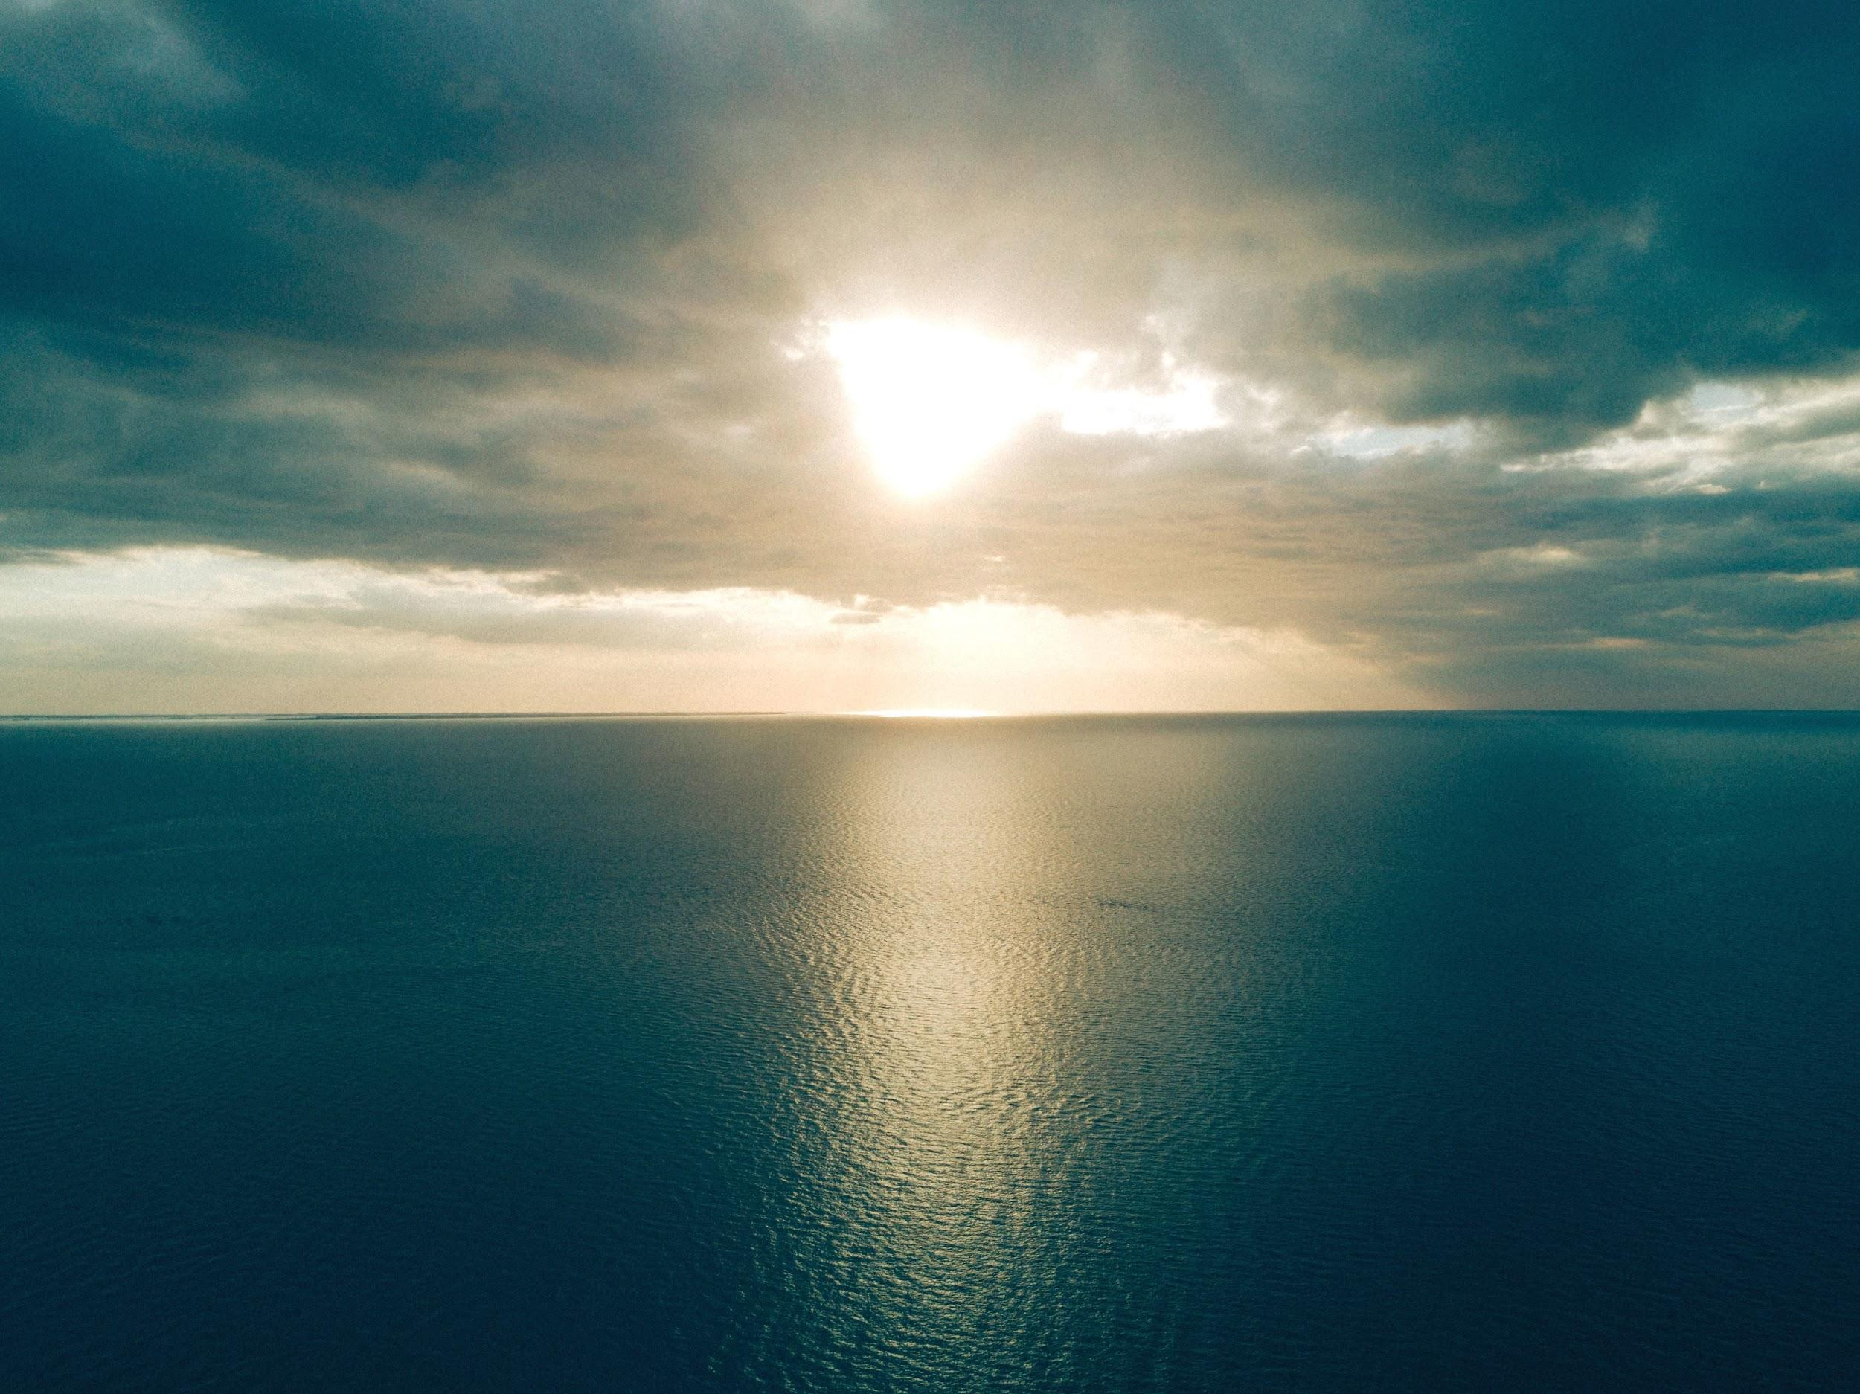
TRAVEL DUCKS
INFO 6150 FINAL PROJECT
ANKITA JHA
002926812
PARTH KATARIA 002964611
PRATIK HARIYA 002929941
SHUBHAM PATIL 002928545

Slide 2
PURPOSE
At Travel Ducks, we believe that at the end you regret places that you didn't go. We enable people to find places to visit
We are four college students who are enthusiast travelers and like to share our travel stories
Creating a platform just for travel and sharing those experiences is like one down in our bucket list

Slide 3
TECHSTACK
API
Google Maps
Weather Stack
Google Places
Middleware
Multer
Database
MongoDB
Other
EmailJS
Webkit Speech Recognition

Slide 4
CONTRIBUTIONS
Ankita Jha
Explore City Feature, Weather Feature, Register, Log in and Log out.
Parth Kataria
Forgot Password Feature, Explore Places Backend and API call, Home Page
Pratik Hariya
Add Experience Page, View Blogs Page, My Account Page, Voice Search
Shubham Patil
Explore Places Page, View Blogs Page, Voice Search, Google Maps API

Slide 5
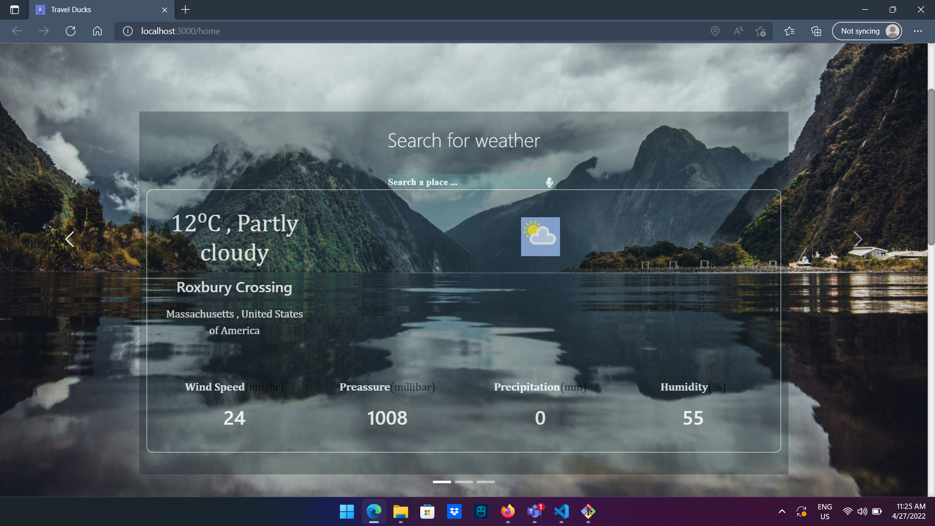

Slide 6
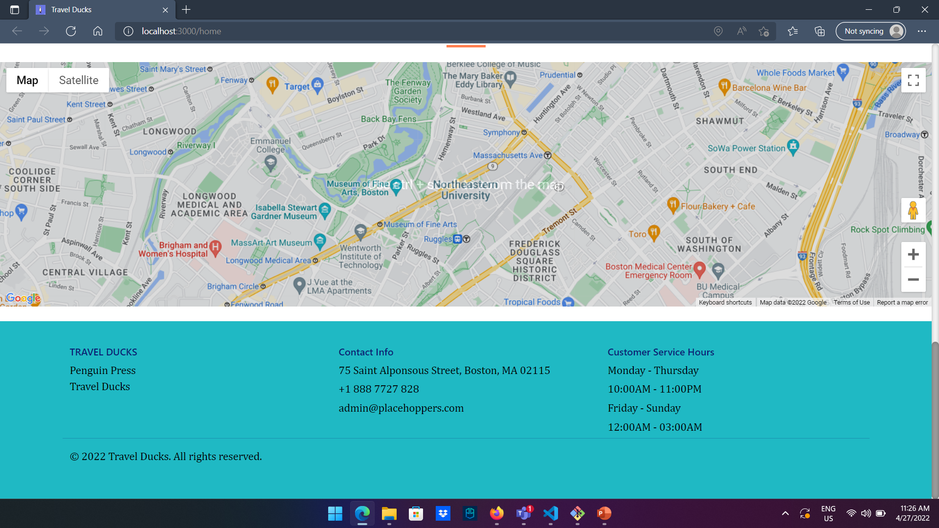

Slide 7
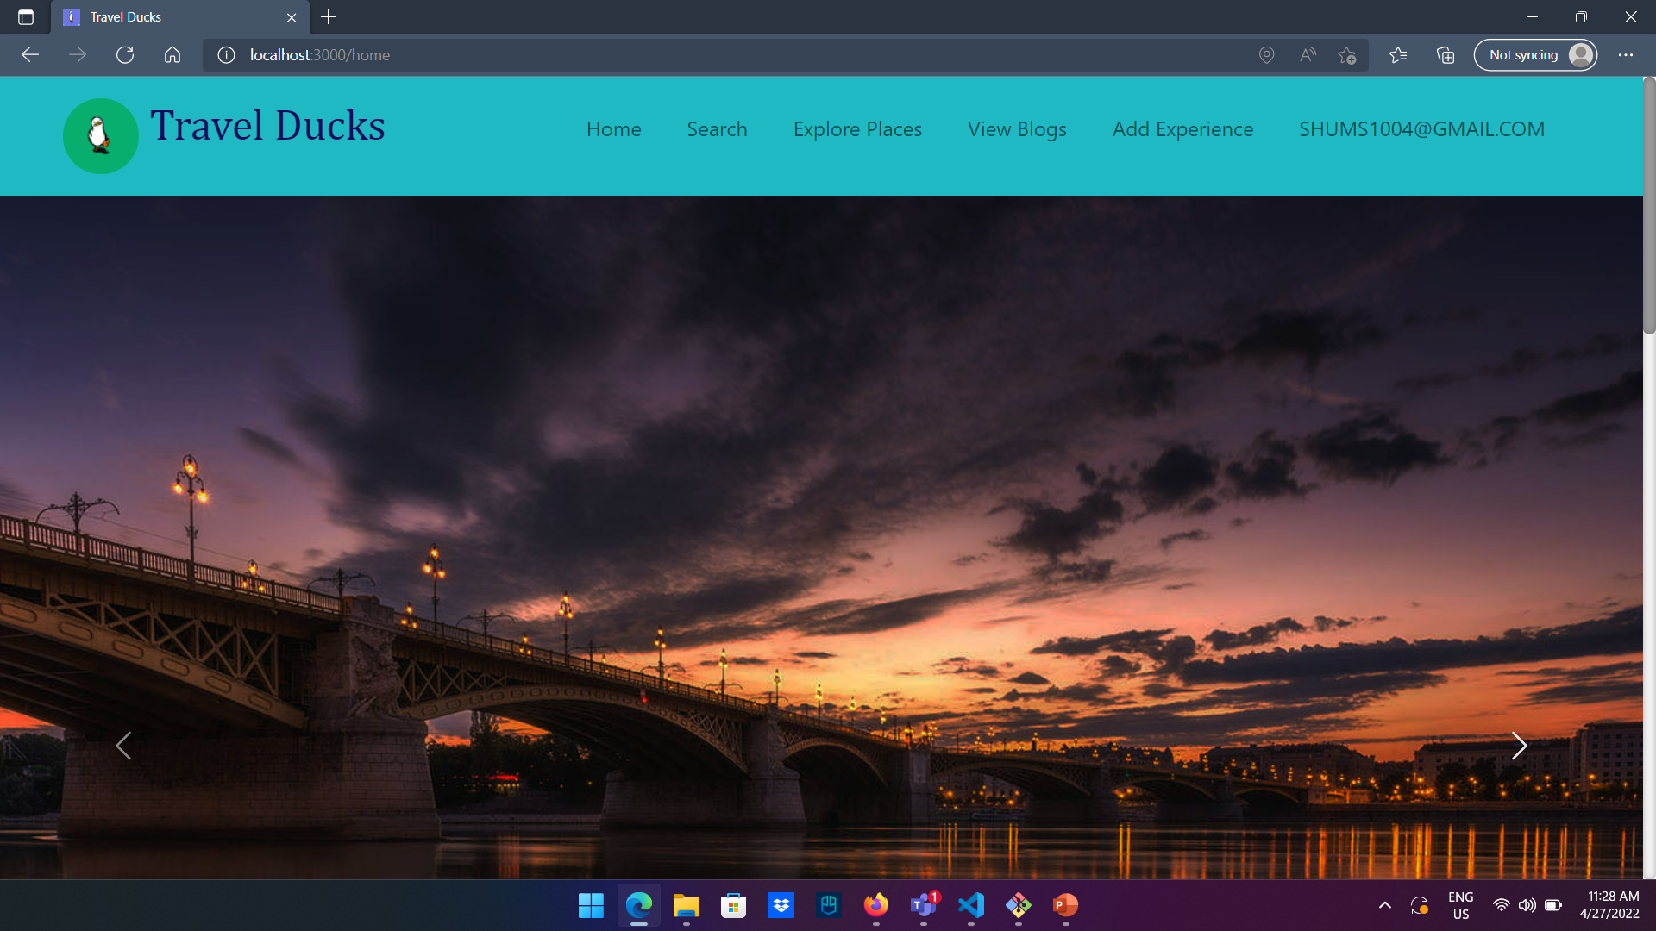

Slide 8
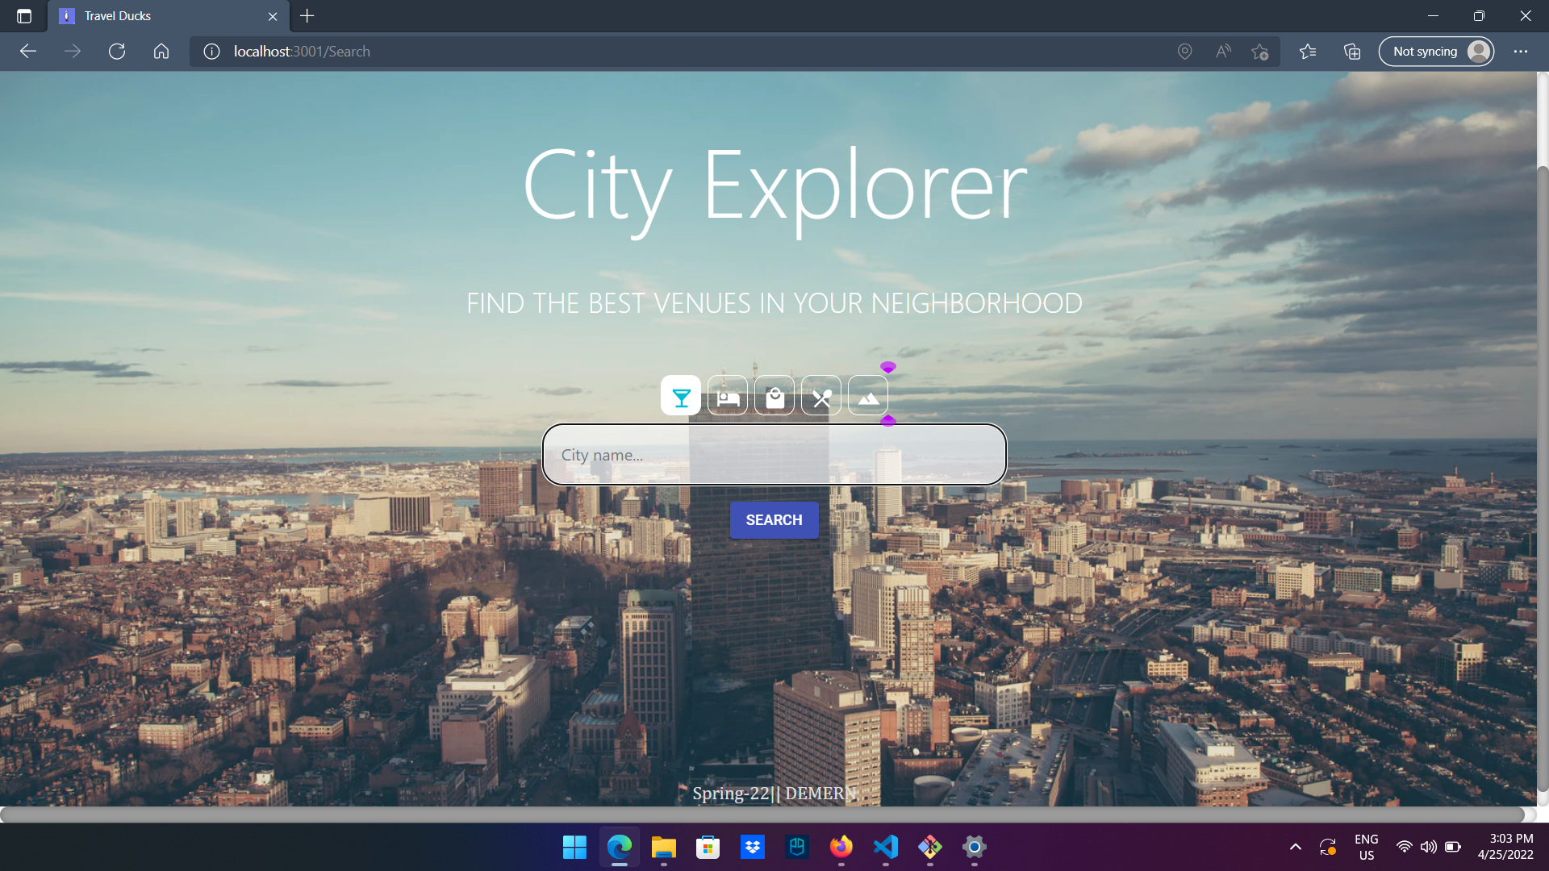

Slide 9
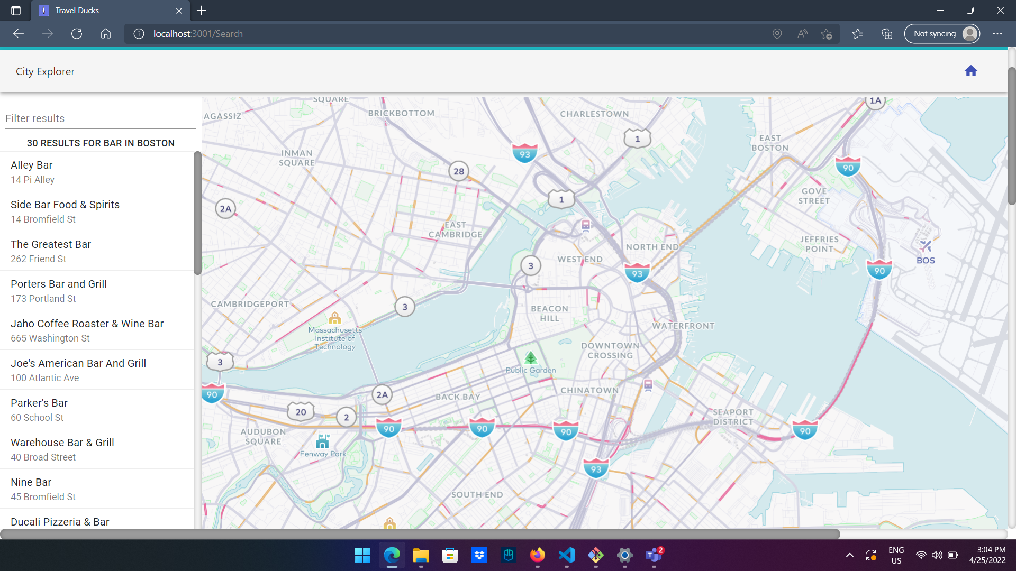

Slide 10
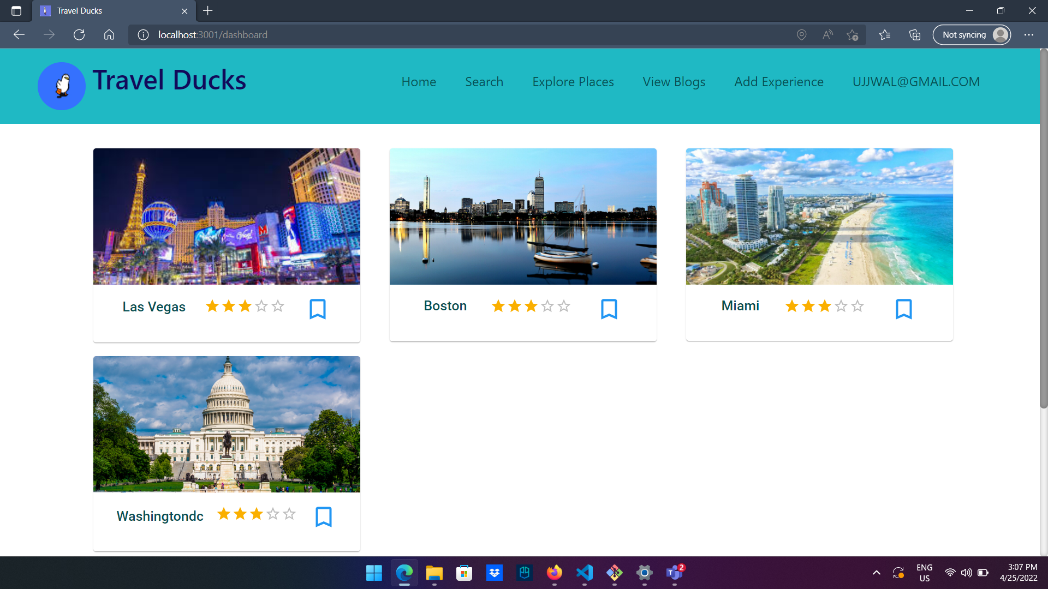

Slide 11
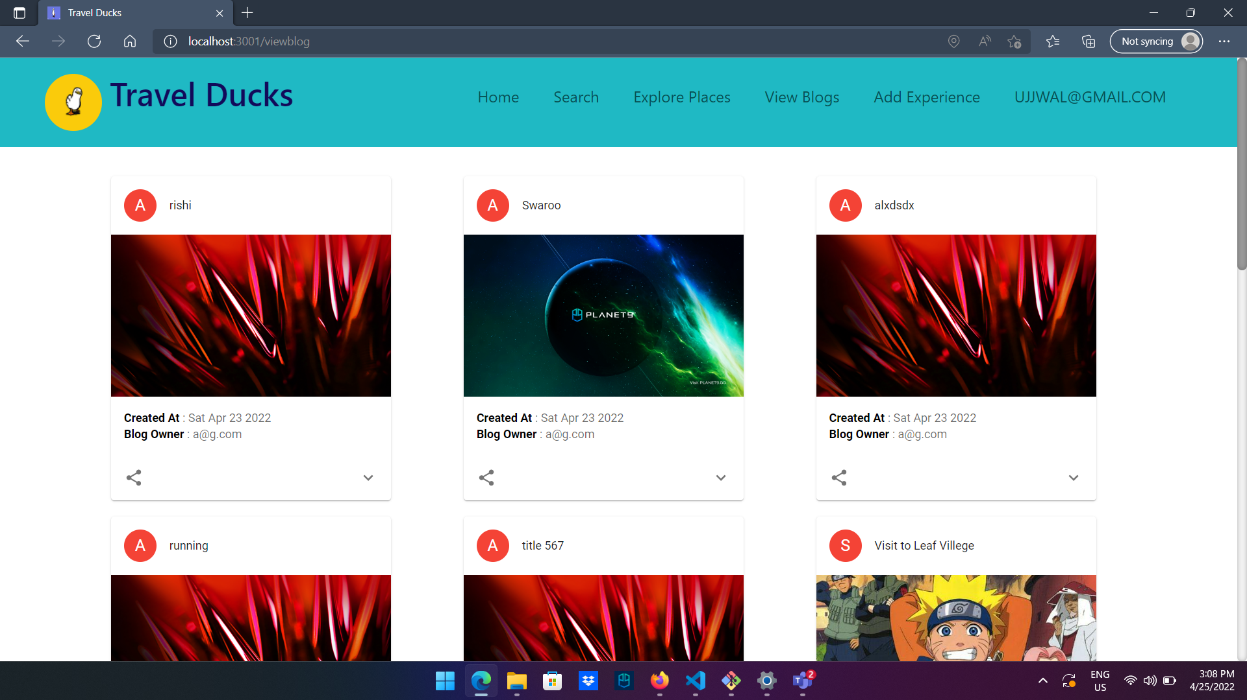

Slide 12
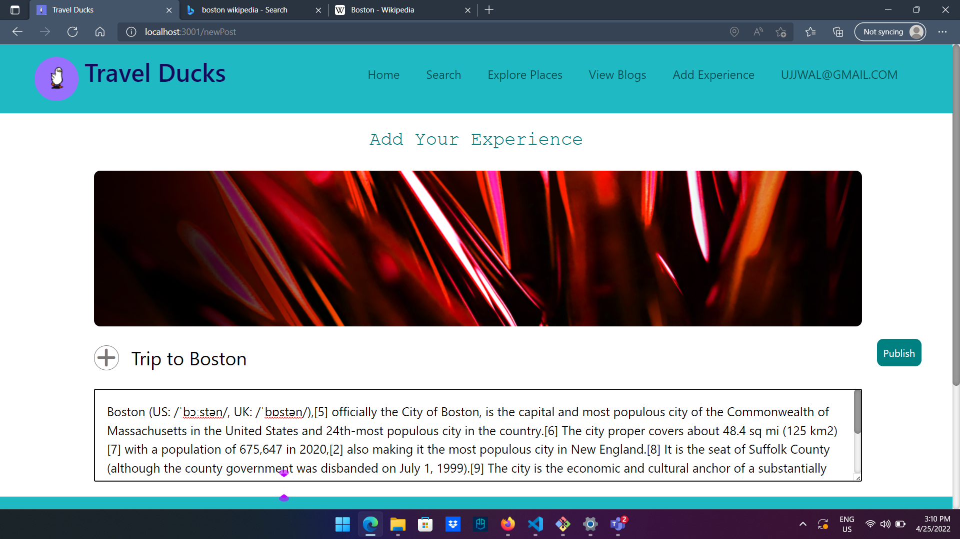

Slide 13
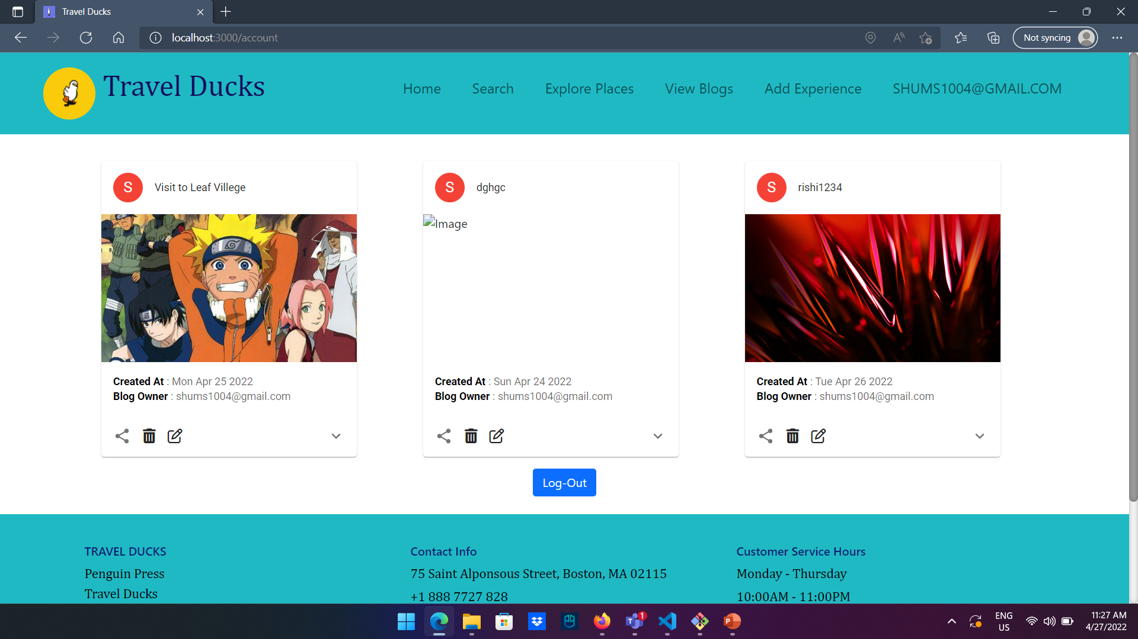

Slide 14
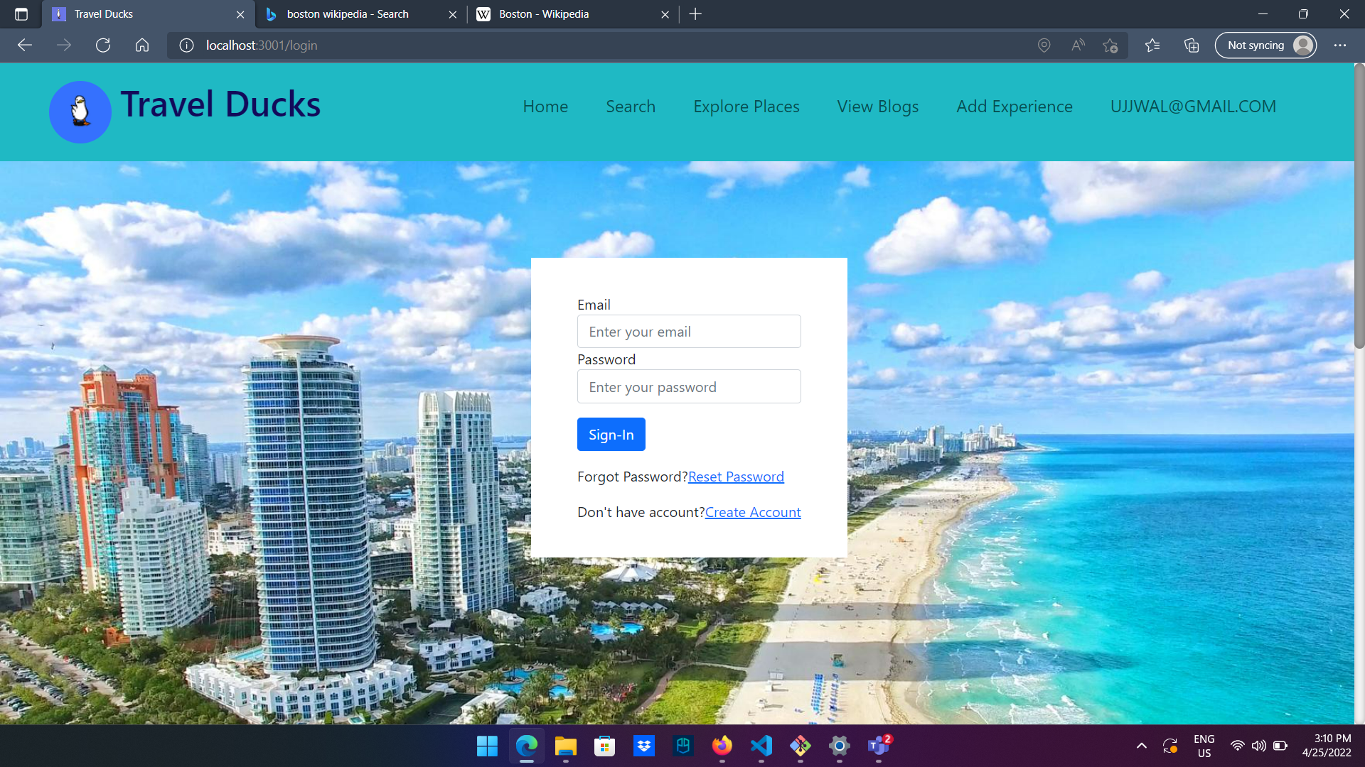

Slide 15
REFERENCES
https://www.tripadvisor.com/
https://mapify.travel/
https://www.emailjs.com/docs/rest-api/send/

